Slide 1
robot arm
serial
manager
unity
(1) set serial port
(2) open serial port
(6) pass on gyro&magnetic values
(3) send start message
(4)send gyro&magnetic values
serial
thread
…
(5) get gyro&magnetic values

Slide 2
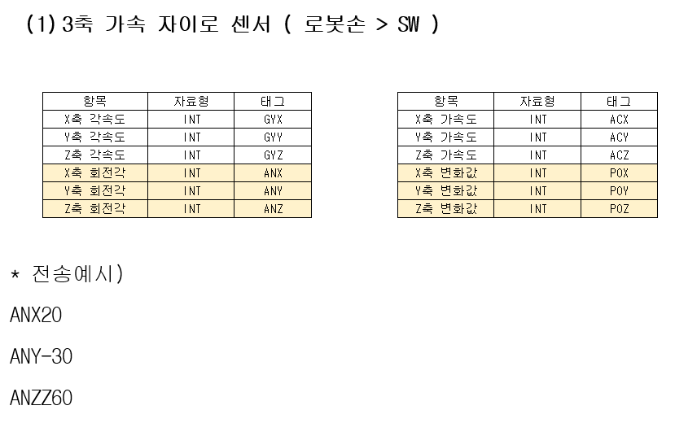

Slide 3
